Slide 1
JAIME FÚSTER DE LA FUENTE ÁLVARO PENDÁS RECONDO MENTOR: PAUL HARVEY
Evolution and Blockchain:
An Autonomous Network Architecture PoC
DIGITAL TWINS TEAM
2022 ITU AI/ML IN 5G CHALLENGE

Slide 2

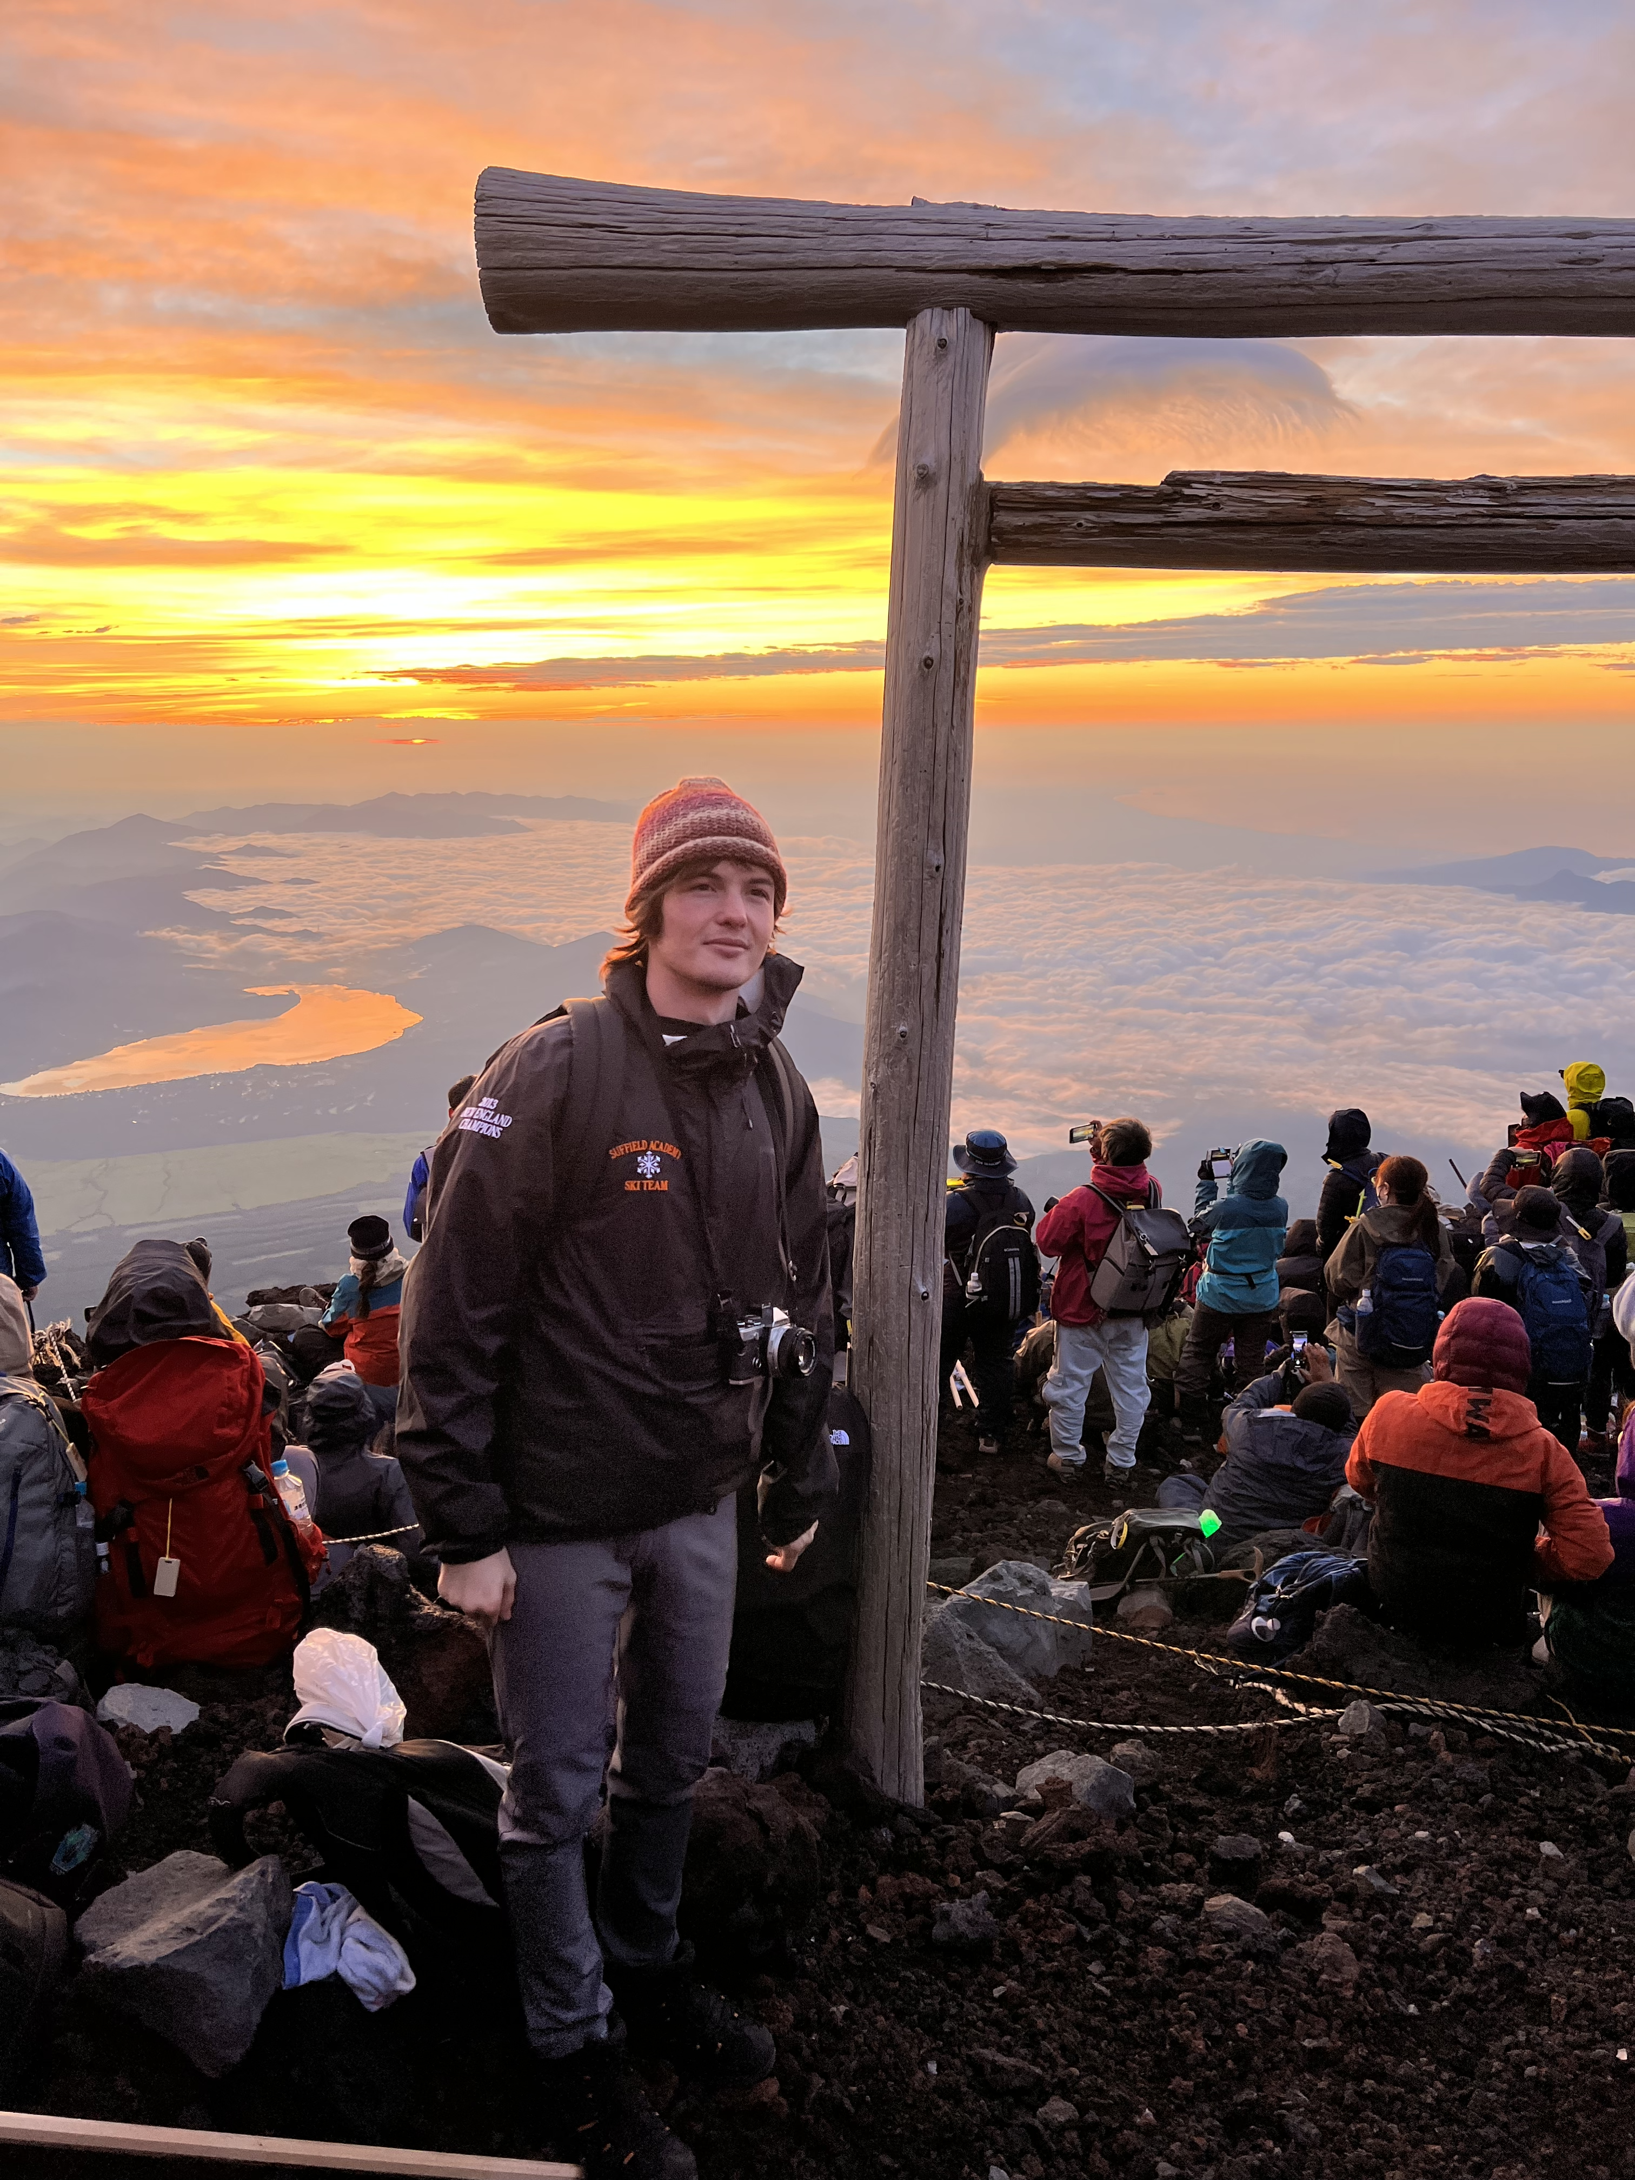
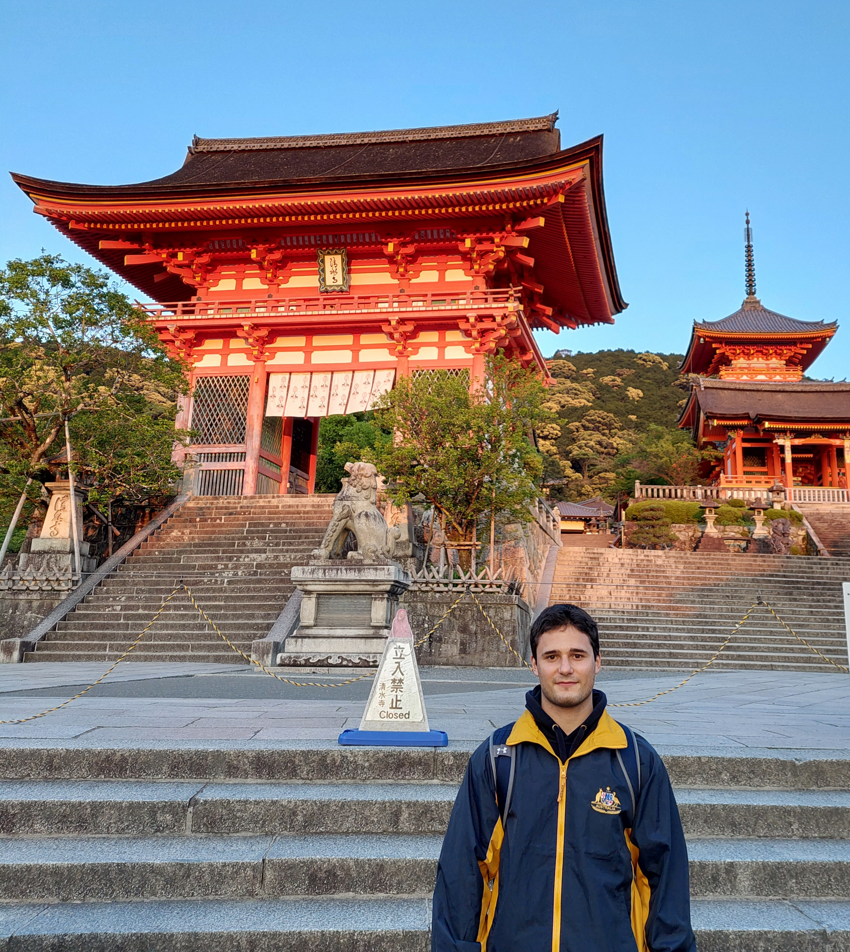


DIGITAL TWINS TEAM
JAIME FÚSTER DE LA FUENTE
ÁLVARO PENDÁS RECONDO​

Slide 3
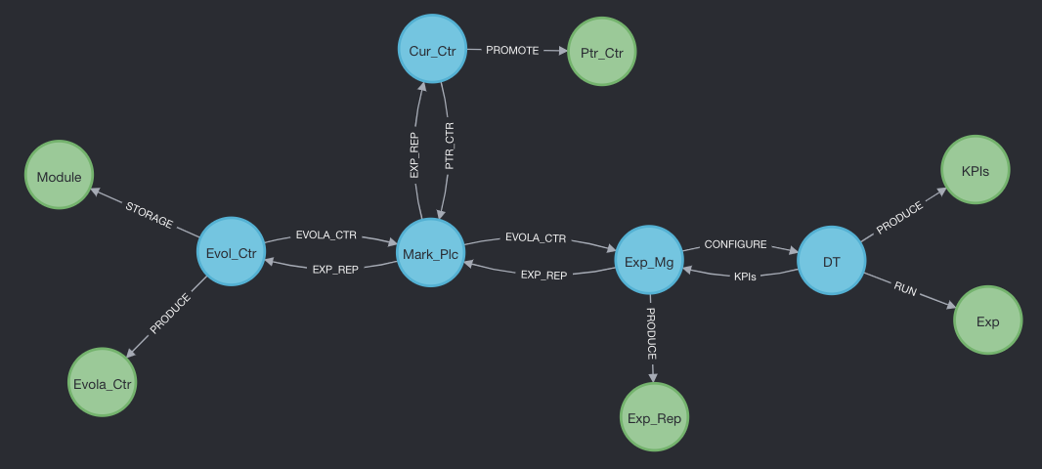








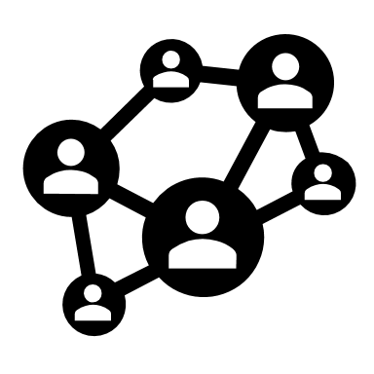

0 – WHAT WE'VE DONE
Trust
Integrity
Auditability/Traceability
Fault tolerance
Scalability
+
=
The Marketplace
Decentralized Architecture for evolution of controllers in an Autonomous Network.

Slide 4
CONTENTS
1 – WHERE DO WE COME FROM?
2 – WHAT IS THE PROBLEM?
3 – WHAT IS OUR SOLUTION?
4 – DOES IT WORK?
5– Q & A

Slide 5
1 - WHERE DO WE COME FROM?
ITU Focus Group on Autonomous Networks (FG-AN)
Build-a-Thon 2022: Build your own Closed Loop

Slide 6
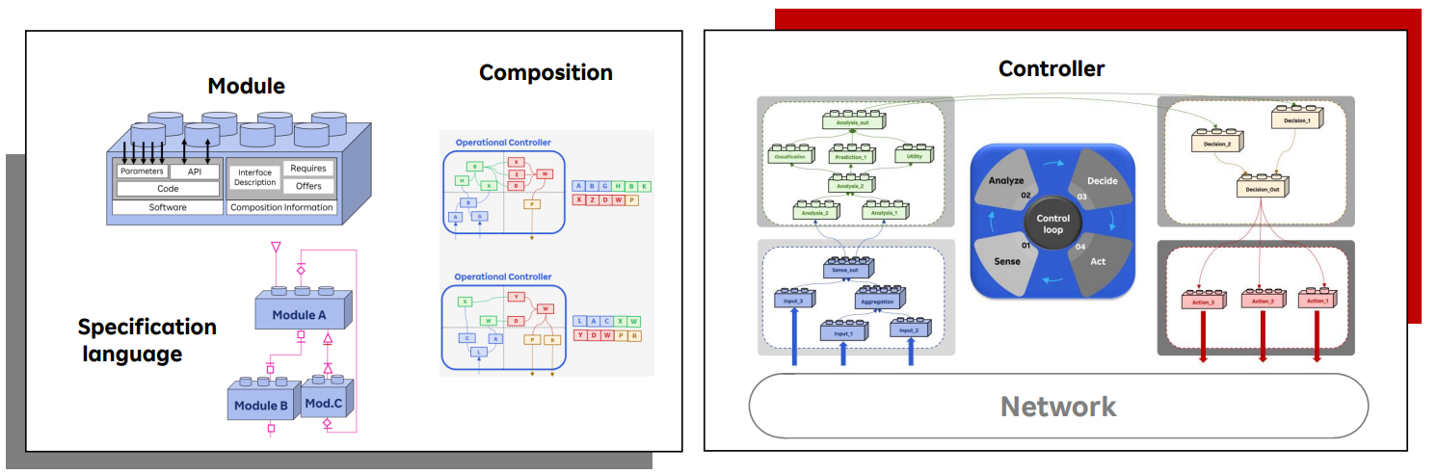
2 – WHAT IS THE PROBLEM?
Autonomous Network: An "Artificial Engineer"
Which are this tools ==> Modules and Controllers

Slide 7
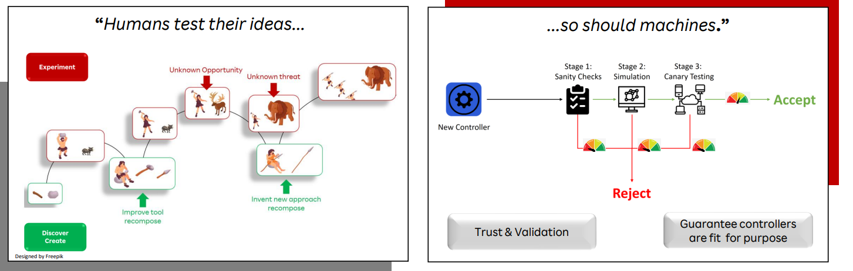
2 – WHAT IS THE PROBLEM?
Autonomous Network
How controllers are composed? ==> Evolution, Evolutionary Algorithms

Slide 8
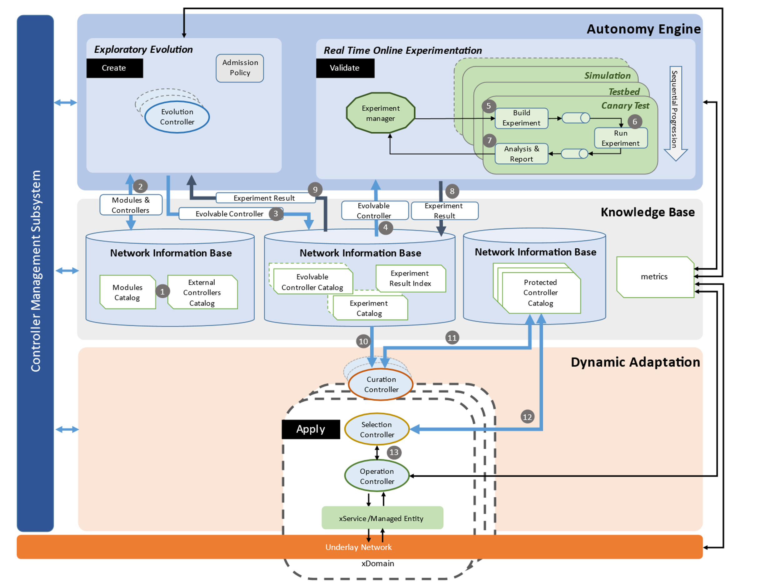
2 – WHAT IS THE PROBLEM?
How do we make Evolution happen?
Architecture
proposed
in FGAN-I-198

Slide 9
2 – WHAT IS THE PROBLEM?
Architecture
proposed
in FGAN-I-198
but... how do we implement
this in reality ...?

Slide 10
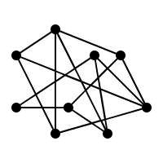








2 – WHAT IS THE PROBLEM?
Autonomous Network
Distributed Architecture
+
=
How do we keep track of changes?
How can we trust each node/information exchanged?
Where is information stored?
How is a controller deployed after being stored?
SOME ISSUES

Slide 11
3 – WHAT IS OUR SOLUTION?
PoC architecture
6
7
1
2
3
6
5
4
ACTORS
ELEMENTS

Slide 12





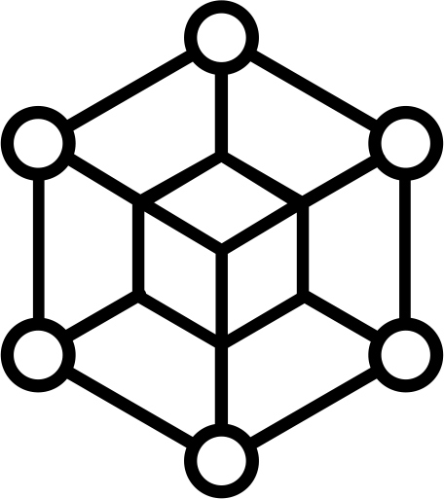
3 – WHAT IS OUR SOLUTION?
Secure and Traceable Evolution​
How to store and access artifacts in a traceable and secure manner?​
Trust
Integrity
Auditability/Traceability
Fault tolerance
Scalability
4
→ We want:
EVOL_CTR
MARK_PLC
EXP_MG
1
5
2
3
Decentralization
Distributed storage
...HOW?
ETHEREUM

Slide 13

3 – WHAT IS OUR SOLUTION?
Private, permissioned blockchain
SCs for uploading and modifying artifacts.
4
EVOL_CTR
MARK_PLC
EXP_MG
1
5
THE
MARKETPLACE
2
3
Distributed, decentralized filesystem.
Integrity ensured through CIDs (Content Identifier)
ETHEREUM

Slide 14
3 – WHAT IS OUR SOLUTION?
THE MARKETPLACE IS EVERYWHERE...

Slide 15

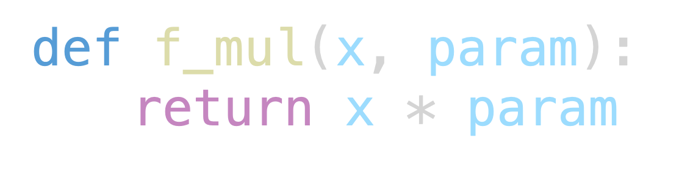
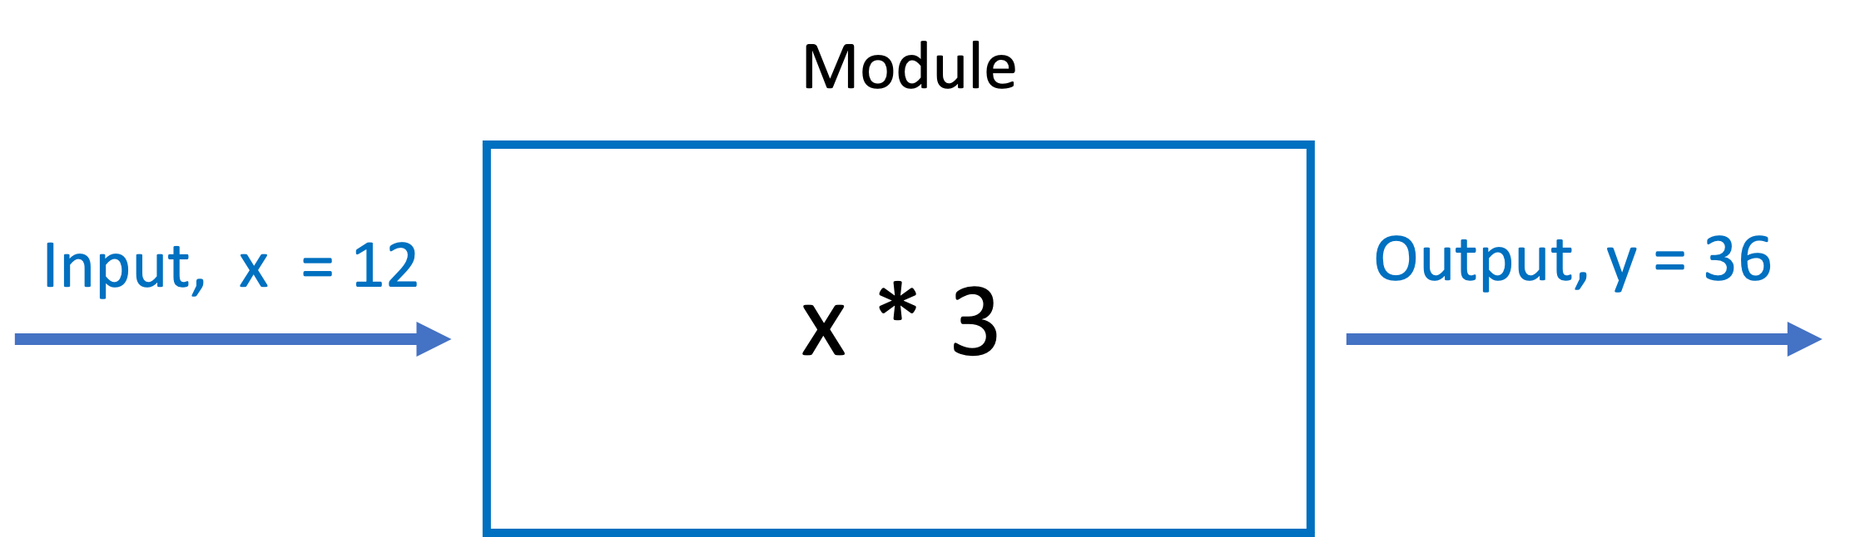
3 – WHAT IS OUR SOLUTION?
PYTHON CLASSES FOR DEFINING MODULES AND CONTROLLERS

Slide 16
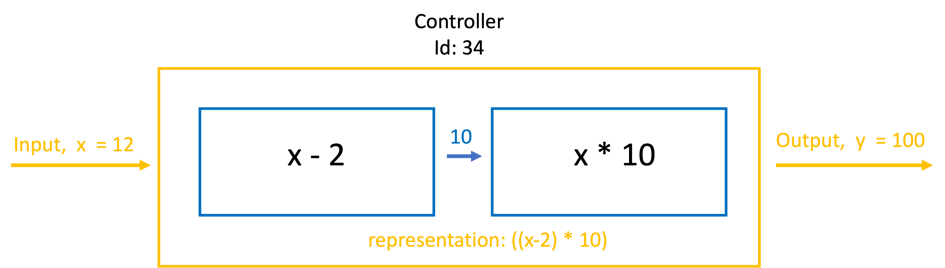
3 – WHAT IS OUR SOLUTION?
PYTHON CLASSES FOR DEFINING MODULES AND CONTROLLERS
TYPE OF MODULE
TUNED PARAMETER

Slide 17




3 – WHAT IS OUR SOLUTION?
TESTING AND EVOLUTION
Communication between nodes
JSON files via HTTP
JSON
JAVASCRIPT
PYTHON
FLASK & GUNICORN

Slide 18
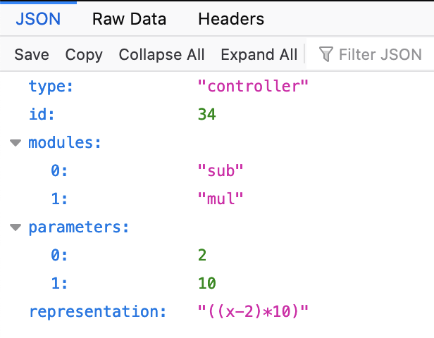
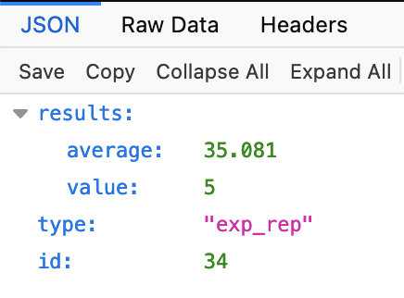
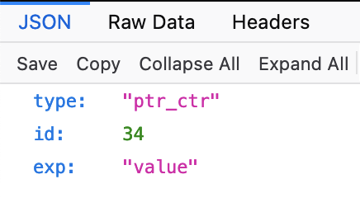
3 – WHAT IS OUR SOLUTION?
JSON REPRESENTATIONS IN THE MARKETPLACE
Controller
Experiment Report
Protected Controller

Slide 19
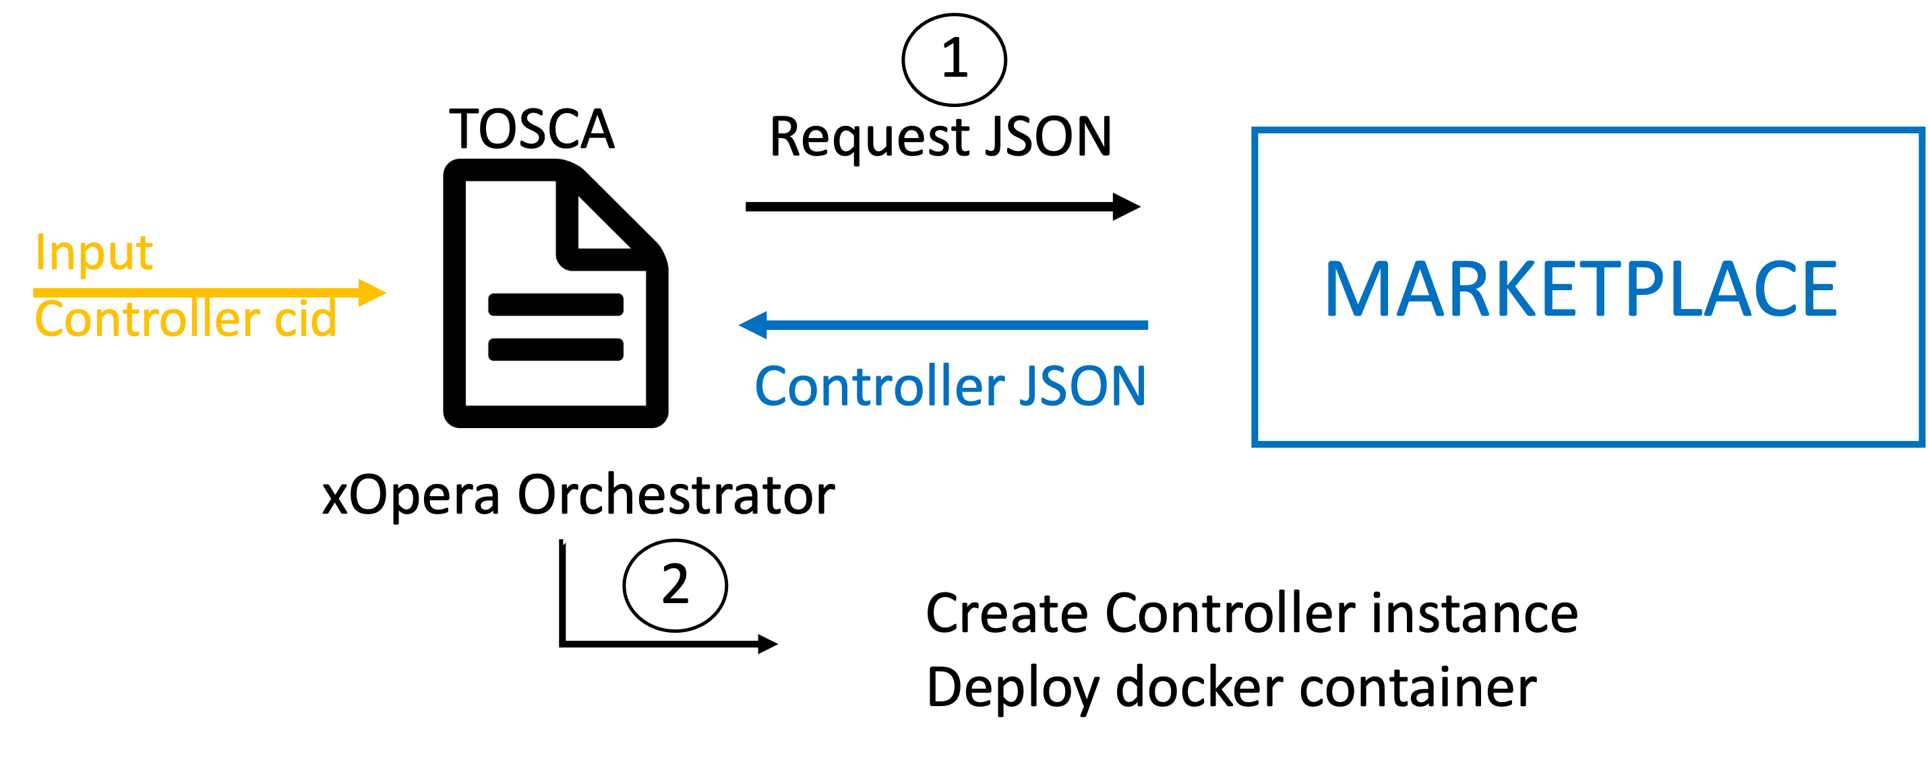

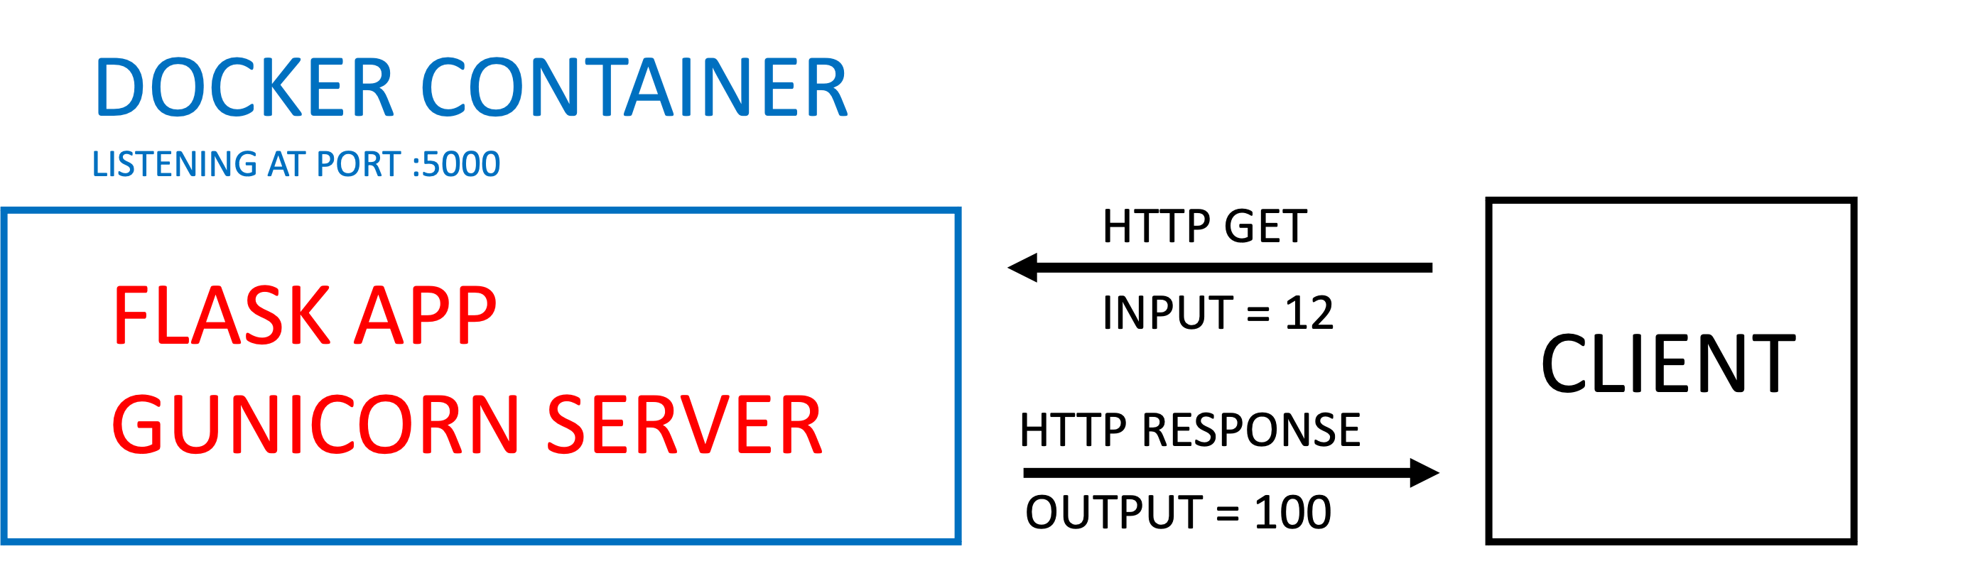

3 – WHAT IS OUR SOLUTION?
AUTOMATIC CONTROLLER DEPLOYMENT
Topology and Orchestration Specification for Cloud Applications

Slide 20
4 – DOES IT WORK?
RECALLING THE INTITIAL ISSUES
Track of changes?
Trust?
Storing the information?
Controller deployment after being stored?
Trust
Integrity
Auditability/Traceability
Fault tolerance
Scalability
+
=
The Marketplace

Slide 21
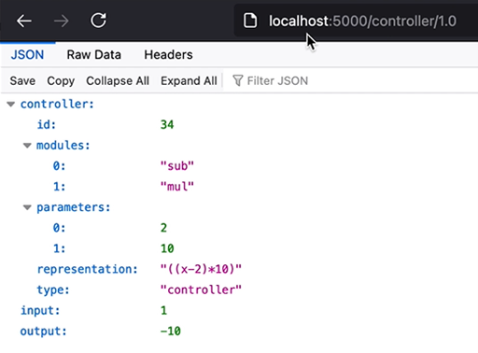
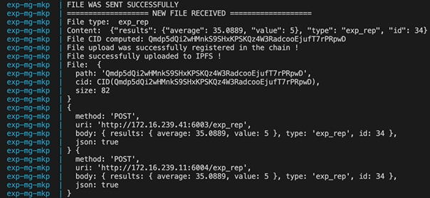
4 – DOES IT WORK?
GITHUB: https://github.com/ITU-AI-ML-in-5G-Challenge/Digital_Twins_Repo
REPORT (Implementation Details and Future Work)
VIDEO DEMO

Slide 22
5– Q & A
Q & A

